Slide 1
Serpent Cipher
Prepared By
Deebthik Ravi - 107116025
Gopik Anand - 107116030

Slide 2
Background
Designed by Ross Anderson, Eli Biham, and Lars Knudsen
A Finalist in the Advanced Encryption Standard(AES) contest, lost to Rijndael
Serpent 0 was a preliminary design that was changed to Serpent 1 for the AES competition
Serpent 1 includes new, stronger S-boxes and a slightly different key scheduling algorithm

Slide 3
Description
It is a Symmetric-key Algorithm
Same key is used for encryption and decryption
Serpent has a block size of 128 bits and supports a key size of 128, 192 or 256 bits.
The cipher is a 32-round substitution-permutation network operation on a block of four 32-bit words.
Each round applies one of eight 4-bit to 4-bit S-boxes 32 times in parallel.

Slide 4
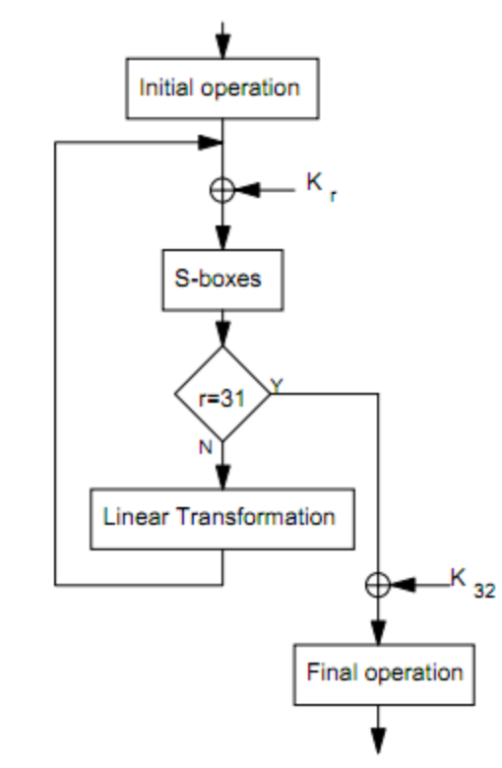
Encryption
Serpent splits the 128 bit block(plaintext) into four 32-bit words. There are 32 rounds. Each round uses a subkey generated from the user key. The user key is fixed at 128, 192, or 256 bits. The algorithm can be summarized as:
An initial permutation(IP)
32 rounds consisting of:
key mixing operation
S-boxes
linear transformation (replaced by a key mixing operation in the final round)
A final permutation(FP)

Slide 5
Initial and Final Permutations
The initial and final permutations are simply bit mappings. This is a very simple method and is especially effective in hardware. In permutations, each bit on the input is assigned to a different index on the output. There are no operations performed, only reassignments.

Slide 6
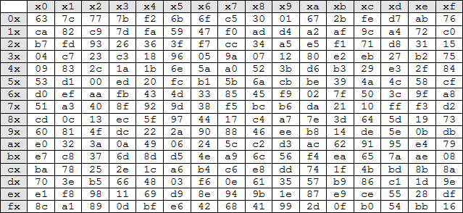
S-boxes
An S-box is simply a look-up-table. In Serpent, the S-boxes are 4-bit to 4-bit permutations. The advantage of an S-box is that for a 1-bit change of an input value, the output is guaranteed to be altered by more than one bit.

Slide 7
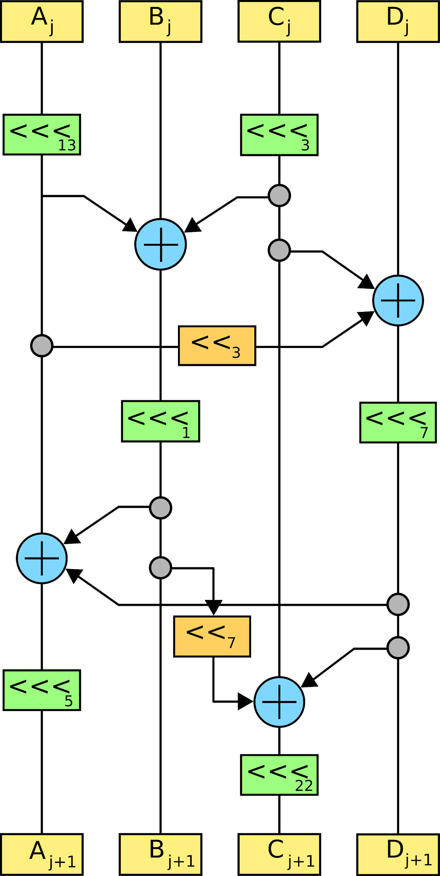
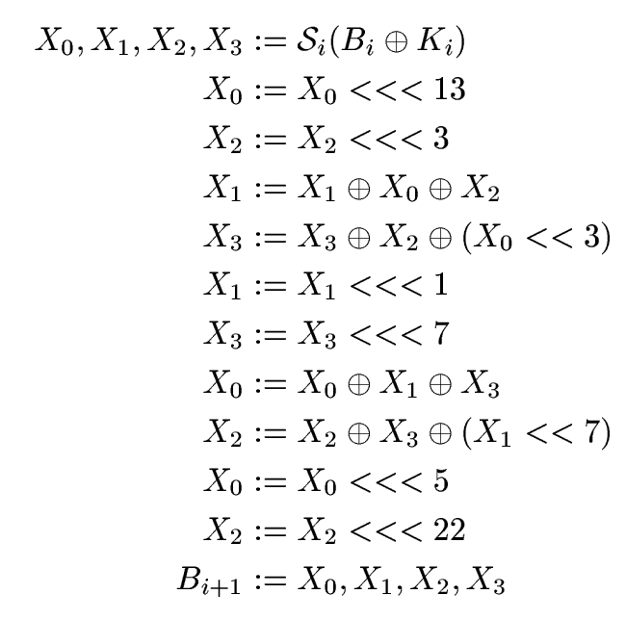
Linear Transformation
The linear transformation functions acts on the 128-bit block as four 32-bit words. Each word is linearly adjusted and combined with other words.

Slide 8
Key Schedule
Keys shorter than 256 are padded on the right.
Round keys are then generated by:
recurrence operation with previous round keys (and the initial key at start)
a pass through one of the 8 S-boxes (starting with S3 and working down)

Slide 9
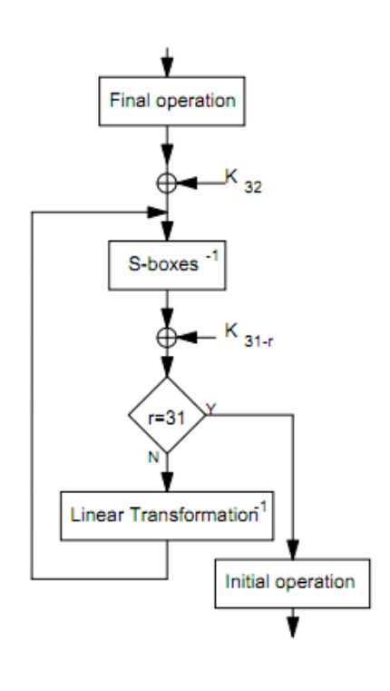
Decryption
Decryption is very similar to encryption. However, inverse S-boxes and linear transformations are used as well as a reverse order of subkeys.

Slide 10
Algorithm Functions
S(box, input): Apply S-box number 'box' to 4-bit bitstring 'input' and return a 4-bit bitstring as the result
SInverse(box, output): Apply S-box number 'box' in reverse to 4-bit bitstring 'output' and return a 4-bit bitstring (the input) as the result
SHat(box, input): Apply a parallel array of 32 copies of S-box number 'box' to the 128-bit bitstring 'input' and return a 128-bit bitstring as the result.
SHatInverse(box, output): Apply, in reverse, a parallel array of 32 copies of S-box number ‘'box' to the 128-bit bitstring 'output' and return a 128-bit bitstring (the input) as the result

Slide 11
LT(input): Apply the table-based version of the linear transformation to the 128-bit string 'input' and return a 128-bit string as the result
LTInverse(output): Apply the table-based version of the inverse of the linear transformation to the 128-bit string 'output' and return a 128-bit string (the input) as the result
IP(input): Apply the Initial Permutation to the 128-bit bitstring 'input' and return a 128-bit bitstring as the result
FP(input): Apply the Final Permutation to the 128-bit bitstring 'input' and return a 128-bit bitstring as the result
IPInverse(output): Apply the Initial Permutation in reverse
FPInverse(output): Apply the Final Permutation in reverse
applyPermutation(permutationTable, input): Apply the permutation specified by the 128-element list 'permutationTable' to the 128-bit bitstring 'input' and return a 128-bit bitstring as the result

Slide 12
R(i, BHati, KHat): Apply round 'i' to the 128-bit bitstring 'BHati', returning another 128-bit bitstring (conceptually BHatiPlus1). Do this using the appropriately numbered subkey(s) from the 'KHat' list of 33 128-bit bitstrings
RInverse(i, BHatiPlus1, KHat): Apply round 'i' in reverse to the 128-bit bitstring 'BHatiPlus1', returning another 128-bit bitstring (conceptually BHati). Do this using the appropriately numbered subkey(s) from the 'KHat' list of 33 128-bit bitstrings
encrypt(plainText, userKey): Encrypt the 128-bit bitstring 'plainText' with the 256-bit bitstring 'userKey', using the normal algorithm, and return a 128-bit ciphertext bitstring
decrypt(cipherText, userKey): Decrypt the 128-bit bitstring 'cipherText' with the 256-bit bitstring 'userKey', using the normal algorithm, and return a 128-bit plaintext bitstring
makeSubkeys(userKey): Given the 256-bit bitstring 'userKey', return two lists (conceptually K and KHat) of 33 128-bit bitstrings each
makeLongKey(k): Take a key k in bitstring format. Return the long version of that key

Slide 13
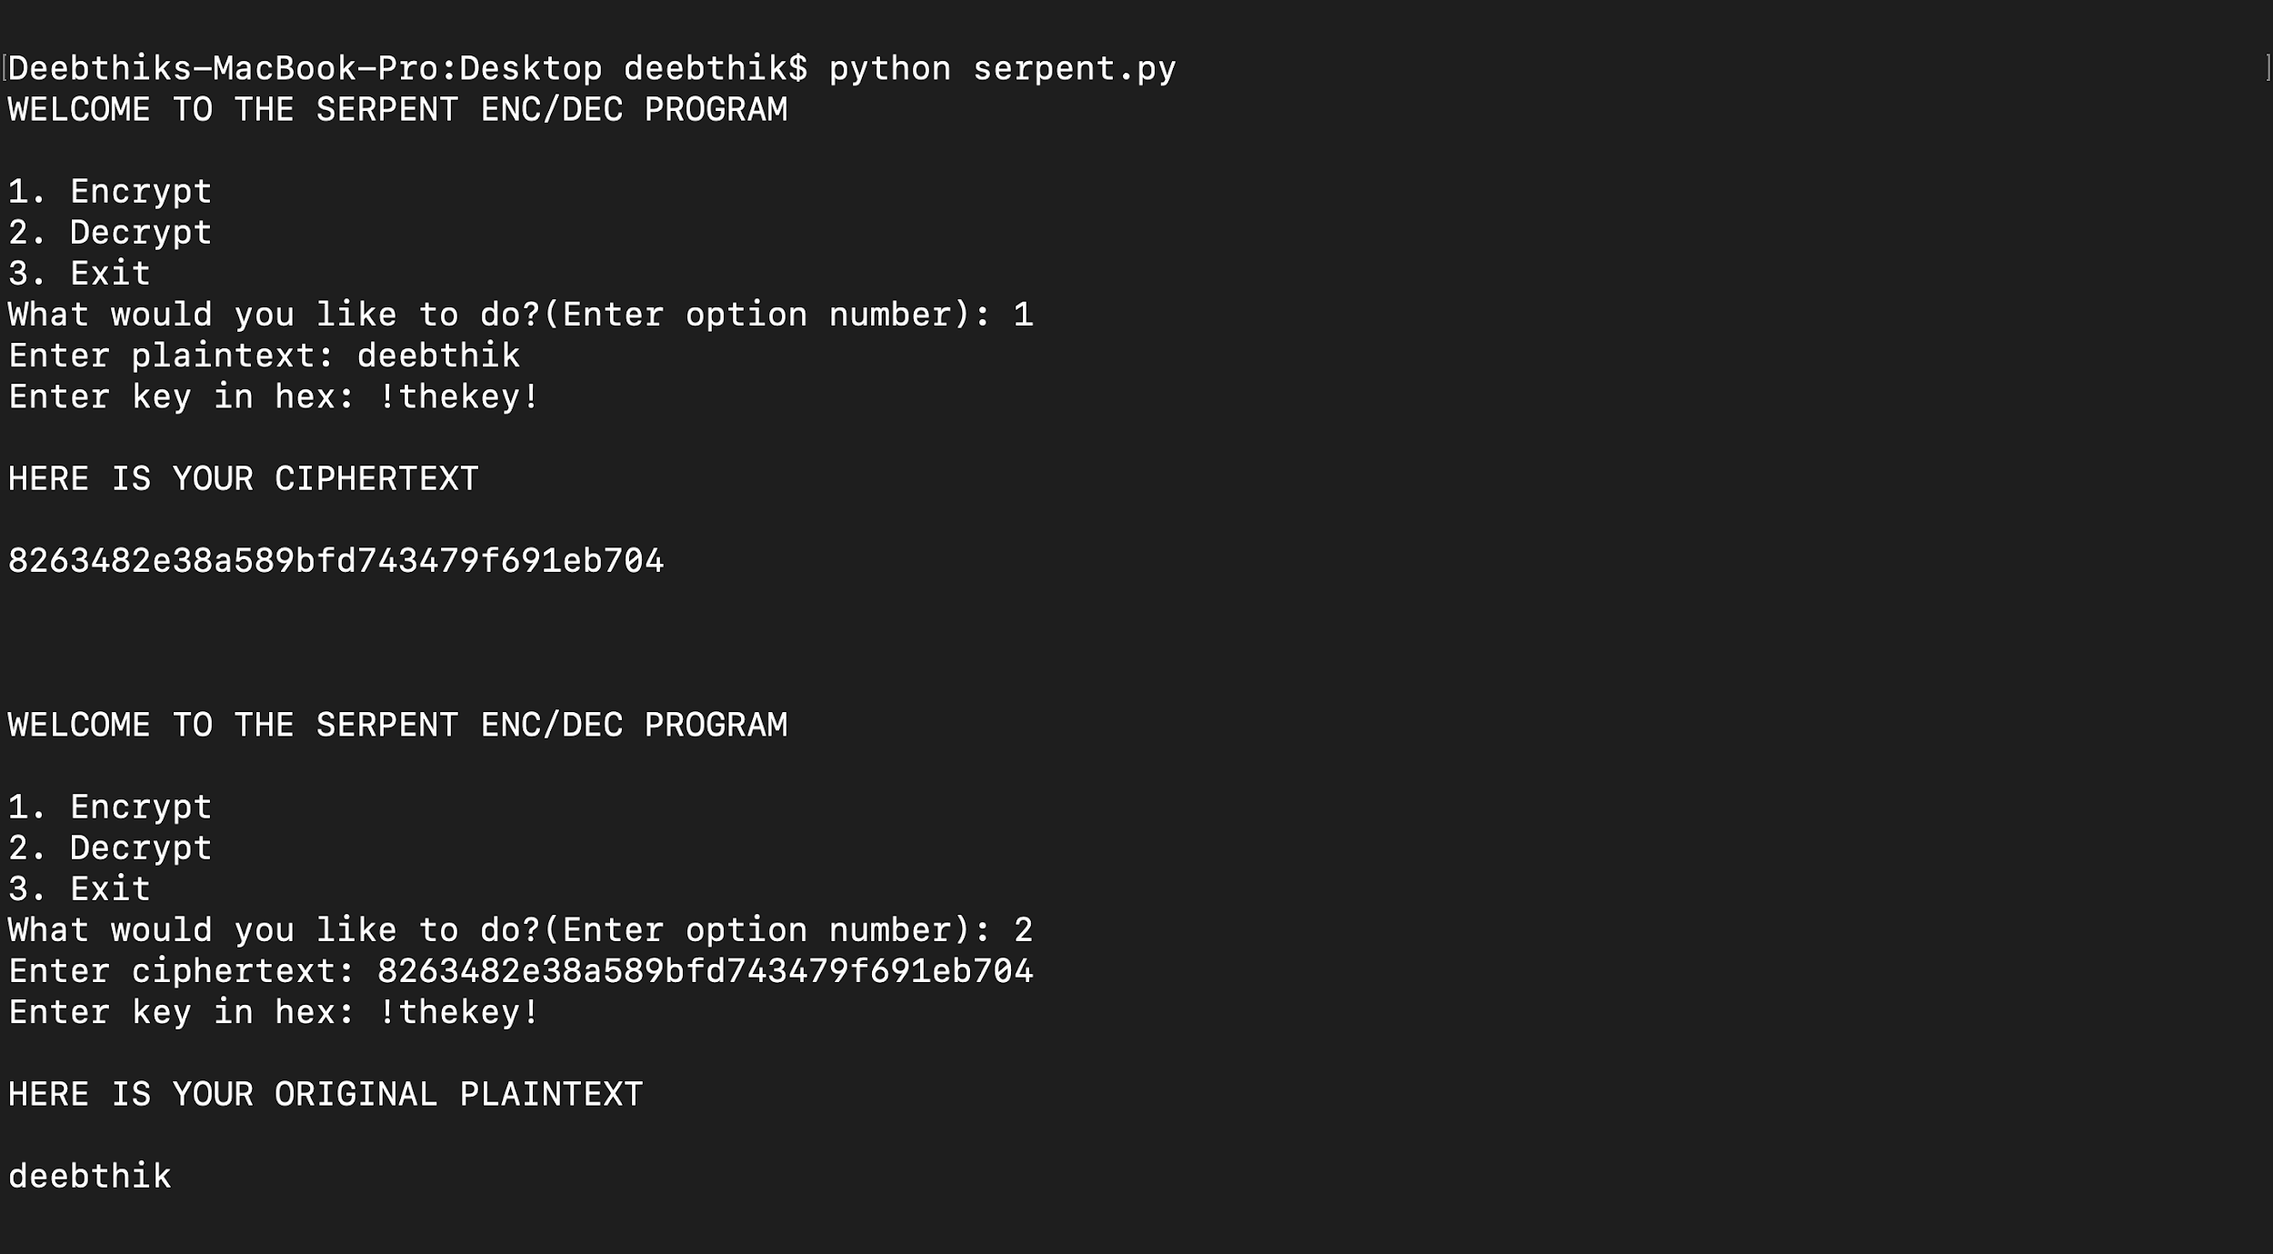
Execution of the code

Slide 14
Advantages of the Serpent Cipher
One of the core ideas of using this algorithm was to not deviate from the already existing study on S-boxes, so from that perspective, it was a very comprehensible algorithm
More secure than triple-DES (if the number of rounds were to be reduced by half, it would still be as secure as the triple-DES)
Was designed so that all operations can be executed in parallel, using 32 bit slices. This maximises parallelism, but also allows the use of extensive cryptanalysis work performed on DES

Slide 15
Applications
Used in a lot of legacy systems, smart cards and banking systems in particular
Implemented in secure file transfer protocols, like FTPS, HTTPS, SFTP, etc.
A few browsers use this algorithm for encrypting a website’s authentication login details when using a master password
Used in routers and remote access servers
Used in secure video teleconferencing

